Slide 1
Monitoring Framework Focus on Aquatic Resources
Anthony (Tony) R. Olsen
USEPA NHEERL
Western Ecology Division
Corvallis, Oregon
(541) 754-4790
Olsen.Tony@epa.gov
Web Page: http://www.epa.gov/NHEERL/ARM

Slide 2
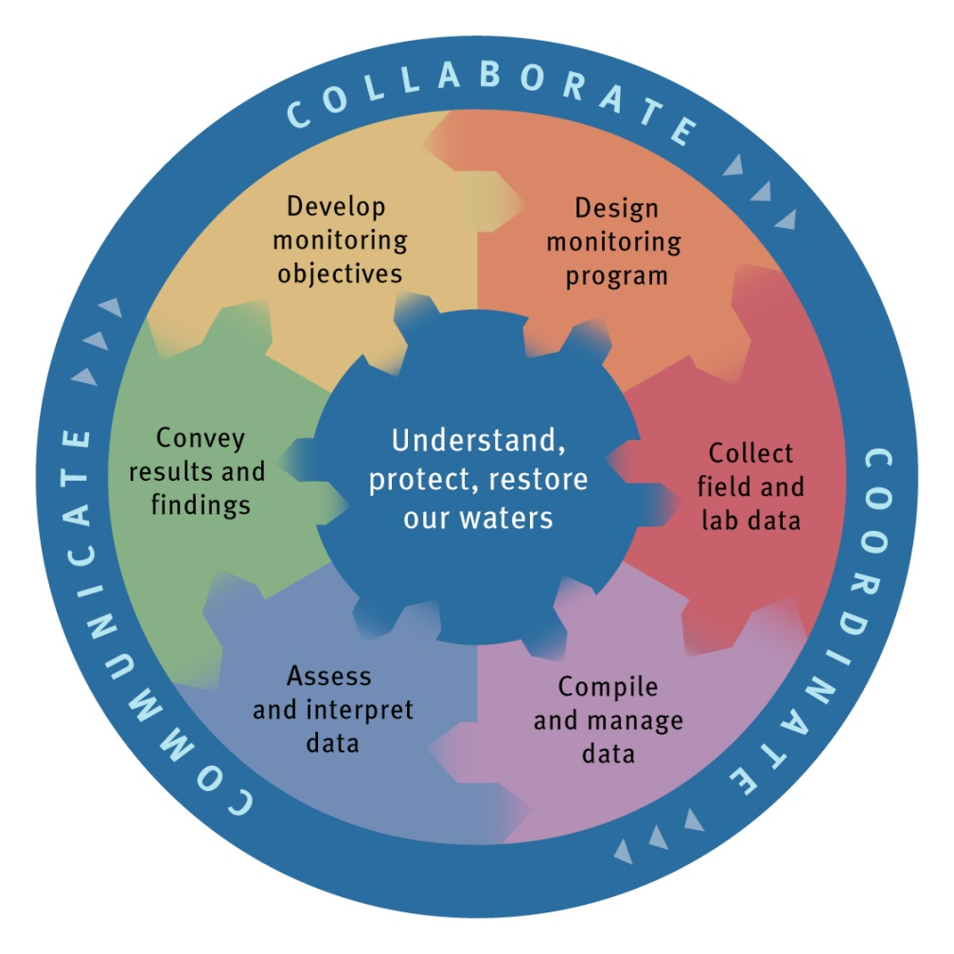
National Water Quality Monitoring Council: Monitoring Framework
View as information system
Monitoring pieces must be designed and implemented to fit together
Implementing a monitoring framework is an iterative process
Reference: Water Resources IMPACT, September 2003 issue

Slide 3
Monitoring Program Weaknesses
Monitoring results are not directly tied to management decision making
Results are not timely nor communicated to key audiences
Objectives for monitoring are not clearly, precisely stated and understood
Monitoring measurement protocols, survey design, and statistical analysis become scientifically out-of-date
Notes:
Why monitor if you are not making a difference.
Fail may be reflected in monitoring program not being adequately funded.
Monitoring programs must continually improve and so must plan for change.

Slide 4
Perspective Change in Aquatic Monitoring
Historical focus on point sources (local) and chemical pollutants
Increased importance of non-point sources and biological/habitat condition
Need for information at multiple scales: site, local, watershed, basin, state, region, national, global
Need to manage at all scales
Increased interest in tying decisions to monitoring information
Reliance on quantitative estimates that can be used in program evaluation and cost-benefit analyses

Slide 5
Generic Questions of Interest
What is the condition of the aquatic resource? (Status)
Where, how, and why are water quality conditions changing over time? (Trends)
What factors are causing these problems? (Associations)
Are management programs working? (Effectiveness)
Are water quality standards being met? (Compliance)

Slide 6
Basin, State, Region, National Scale Questions
Status
Assessment: How many stream miles, number of lakes, or estuarine hectares meet WQS or satisfy aquatic life use based on IBI scores?
Condition: What proportion of streams, lakes, and estuaries are in good ecological condition?
Trends
How has the proportion of stream miles, number of lakes, or estuarine hectares meeting WQS or satisfy aquatic life use based on IBI scores changed over time?
Has the proportion of streams, lakes, and estuaries in good ecological condition changed between 2000 and 2010?

Slide 7
Basin, State, Region, National Scale Questions
Associations
What factors are associated with aquatic resources that do not meet WQS?
How does riparian habitat quality relate to the EPT Index ?
Regulatory
What should nutrient criteria be? By ecoregion?
Management
What proportion of the estuarine area has non-point source water quality issues?
How effective have non-point source best management practices been in improving water quality within the state?
What proportion of streams are being affected by urbanization?

Slide 8
Local Scale (Site Specific) Questions: Important but not topic addressed here
Is the waste water treatment plant discharge having an effect on the coastal waters?
Is storm water runoff from a contaminated site clean?
Has agricultural runoff caused the degradation in the tidal bay?

Slide 9
Convey
Develop
Design
Results
and
monitoring
monitoring
objectives
program
findings
Establishing monitoring objectives drives entire monitoring framework process
Useful to consider reporting of results when defining objectives
Objectives provide critical information to design step

Slide 10
Convey
Develop
Design
Results
and
monitoring
monitoring
objectives
program
findings
Kish (1965): “The survey objectives should determine the sample design; but the determination is actually a two-way process…”
Initially objectives are stated in common sense statements – challenge is to transform them into quantitative questions that can be used to specify the design.
Statistical survey design perspective leads to
Knowing whether a monitoring design can answer the question
Knowing when the question is not stated precisely enough to chose a survey design
Notes:
Useful to think about what tables and graphics will be used to convey results and findings in a report. Do this assuming that can visit all sites (ie ignore the issue of site selection). Also useful to think about what the monitoring program would present to decision-makers when they only have 15-20 minutes to make the presentation. Helps focus on high priority objectives. I recognize that data from a monitoring program will be summarized and used in many ways that was not anticipated – that is fine. What don’t want to do is lose sight of what key information is required by decision-makers and public.
Developing monitoring objectives must be done in the context of institutional constraints. That is a major reason it is difficult. Major institutional constraint is funding. It makes a difference if are designing for a $1M, $10M, or $100M national monitoring program.

Slide 11
Monitoring Questions Provide Information Required at Design Step
Develop
monitoring
objectives
Spatial domain & spatial unit
Spatial domain is geographic region over which study will be conducted
Spatial domain usually consists of a collection of spatial units
Temporal domain & temporal unit
Temporal domain is entire length of time the study will collect data
Temporal domain may consist of a collection of temporal units
Indicators state what will reported and drive what will be measured
Reporting domain
Specific collection of spatial-temporal units in the spatial and temporal domain for which indicator results will be reported.

Slide 12
Indicators, metrics & measurements
Develop
monitoring
objectives
Measurement is a value resulting from a data collection event which is taken on or within a spatial-temporal unit using protocols described in what is called the response design
Metric is the spatial-temporal unit value resulting from the reduction or processing of measurements as described in the response design
Indicator is the reporting domain value resulting from the processing of metrics across spatial-temporal units as described by what is called the inference design

Slide 13
Developing Monitoring Objectives
Develop
monitoring
objectives

Slide 14
Identify Monitoring Objectives
Develop
monitoring
objectives
Monitoring program weakness: Objectives for monitoring are not clearly, precisely stated and understood
Objectives must be linked to management decisions and reporting requirements
Objectives determine the monitoring design
Usual to have multiple (many) objectives
Precise quantitative statements are required
Objectives must be prioritized
Objectives compete for samples

Slide 15
From Questions to Objectives: Stream Example
Develop
monitoring
objectives
What is the overall quality of waters in the state of Yucatan?
What is the overall quality of streams with flowing water during summer in Yucatan?
What is the biological quality of streams with flowing water during summer in Yucatan?
How many km of streams with flowing water during the summer have a benthic macroinvertebrate index (BMI) value greater than 75 within Yucatan?
How is BMI determined?
What is meant by summer?
What is meant by flowing waters?
What about time?
Estimate required every year?
Once every 5 years?
Notes:
Want the objective to require a quantitative answer that can be used by management.

Slide 16
Stream Example: Design Requirements
Develop
monitoring
objectives
Spatial Domain: Yucatan state
Spatial Unit: All possible locations on streams with flowing water within Yucatan
Temporal Domain: 2011 to 2020
Temporal Unit: Year
Reporting Domains: Yucatan annually
Indicator: Length (km) of streams with flowing water within Yucatan with BMI less than 45 reported annually
Metric: BMI value at a stream location determined annually
Measurement: Benthic macroinvertebrate assemblage determined in summer

Slide 17
From Questions to Objectives: Coastal Waters Example
Develop
monitoring
objectives
What is the overall condition of coastal waters in Mexico?
What is the overall condition of estuaries on east coast?
What is the biological quality of Terminos Lagoon during summer?
How many hectares of Terminos Lagoon have a benthic macroinvertebrate index (BMI) value less than 45?
How is BMI determined?
What is meant by summer?
What is the boundary of Terminos Lagoon?
What about time?
Estimate required every year?
Once every 5 years?
Notes:
Want the objective to require a quantitative answer that can be used by management.

Slide 18
Coastal Waters Example: Design Requirements
Develop
monitoring
objectives
Spatial Domain: Terminos Lagoon
Spatial Unit: All possible locations within spatial domain
Temporal Domain: 2011 to 2020
Temporal Unit: Year
Reporting Domains: Terminos Lagoon annually
Indicator: Area (hectares) of Terminos Lagoon with BMI less than 45 reported annually
Metric: BMI value at point determined annually
Measurement: Benthic macroinvertebrate assemblage determined in summer

Slide 19
Spatial Unit Options
Develop
monitoring
objectives
Coastal waters spatial domain viewed as continuous surface
Spatial units are all possible locations on surface of coastal waters
Metric values determined for each sampled location, i.e., point
Lake spatial unit options
Lakes as discrete spatial units
Each lake is represented as a point (e.g. lake centroid)
Metric values determined for each lake sampled
Lakes as continuous surface
Spatial units are all possible locations on surface area of lakes
Metric values determined for each sampled location within lake surface area

Slide 20
Stream Spatial Unit Options
Develop
monitoring
objectives
Spatial units are all possible locations on the stream network (linear network) within the spatial domain
Infinite number of locations
Metric value determined at each sampled location
Spatial units are all predefined stream segments on the stream network within the spatial domain
Finite collection of segments
Metric value determined for each sampled segment

Slide 21
Reporting Domains
Subsets of the target population that are of particular interest
Examples
Ecoregions, biogeographic regions
All lakes in region with area < 100 ha
All wadeable streams and rivers
All depressional wetlands
Terrestrial surface area within 1 km of road or trail system
All terrestrial surface area classified as open meadow

Slide 22
Reporting Domains: Impact on Design
Objectives identify critical subpopulations with expected sample sizes: Domains
Survey design addresses domain sample size requirements
Explicitly using stratification or unequal weighting
Implicitly when other requirements provide sufficient sample sizes
Some subpopulations can not be identified prior to sample selection
Identification requires field evaluation
More difficult to guarantee sample size in this case

Slide 23
What Statistical Quality is Required for Indicator Results?
Statistical quality: Margin of error:
Is a common summary of sampling error that quantifies the uncertainty about a survey result
is defined as the half-width of confidence interval at a specified confidence level (typically 90% or 95%)
Statistical quality: Power of tests
Power of detecting a change between two period
Power of detecting a trend over the temporal domain
Decisions drive sample size requirements for each reporting domain
Constraints: funding, organization capabilities
Decision makers should specify based on the value of monitoring information in decision making

Slide 24
STRIDe Approach to Design
Design
Monitoring
Program

Slide 25
STRIDe Approach to Designing a Monitoring Program
Design
monitoring
program
Spatial design: how we select what spatial units to monitor within the spatial domain
Temporal design: how we select what temporal units to monitor within the temporal domain
Response design: what measurements we make, how we take them & how we calculate metrics on spatial-temporal units based on the measurements
Inference Design: how we summarize metrics across spatial-temporal units within a temporal domain to obtain indicator value for a reporting domain
Notes:
“What will be measured” is not considered in this presentation.

Slide 26
Spatial Domain and Units: Building Blocks for Spatial Design
Design
monitoring
program
Spatial domain and its spatial units define the target population
Target population
Requires a clear, precise written definition
Must be understandable to users
Field crews must be able to determine if a particular site is included
More difficult to define than most expect.
Includes definition of what the spatial units (elements) are that make up the spatial domain
Definition is written and usually not given in terms of a GIS layer

Slide 27
Spatial Design & Representative Sample
Design
monitoring
program
Goal is to obtain a “representative sample” of the target population that can be used to make inferences from the metric values on the sampled spatial units to indicator values for a reporting domain
Problem: At least 9 definitions for representative sample
General acclaim for data
Absence of selective forces
Miniature of the population
Typical or ideal case(s)
Coverage of the population
Vague term, to be made precise
Representative sampling as a specific sampling method
Representative sampling as permitting good estimation
Representative sampling as good enough for a particular purpose.
Notes:
Kruskal, W., and Mosteller, F. (1979), "Representative Sampling, I: Non-Scientific Literature," International Statistical Review, 47, 13-24.
Kruskal, W., and Mosteller, F. (1979), "Representative Sampling, II: Scientific Literature, Excluding Statistics," International Statistical Review, 47, 111-127.
Kruskal, W., and Mosteller, F. (1979), "Representative Sampling, III: The Current Statistical Literature," International Statistical Review, 47, 245-265.

Slide 28
Types of Statistical Designs
Design
monitoring
program
Experimental designs
Random allocation of treatments to spatial units
Focus on testing not estimation
Observational studies
Factor space designs (e.g. gradient studies, coverage of population)
Opportunistic designs (professional judgment, ease of access)
Survey designs
Census
Probability survey design
Model-based survey design

Slide 29
Basic Spatial Survey Designs
Design
monitoring
program
Simple Random Sample
Systematic Sample
Regular grid over an area
Regular spacing on linear resource
Spatially Balanced Sample
Combination of simple random and systematic
Guarantees all possible samples are distributed across the target population
Generalized Random Tessellation Stratified (GRTS) design

Slide 30
Why aren’t Basic Designs Sufficient in Many Cases?
Design
monitoring
program
Monitoring objectives may include requirements that basic designs can’t address efficiently
Estimates for particular Reporting Domains requires greater sampling effort
Administrative restrictions and operational costs
Ecological resource occurrence in study region makes basic designs inefficient
Resource is known to be restricted to particular habitats

Slide 31
Stratification: Reasons to Use
Design
monitoring
program
Administrative or operational convenience
Regions or states need to be operationally independent
Particular portions of the target population require different survey designs
Design for extensive wetlands (Everglades) may be different from prairie pothole wetlands
Increase precision by constructing strata that are homogeneous
Reporting domains identified require additional samples to meet margin of error requirements

Slide 32
More complex Survey Designs
Design
monitoring
program
Unequal probability sample
Alternative to stratification
Requires auxiliary information
Spatial strata random sample
Don’t have a list frame
Alternative way to spatially balance sample
Cluster sample
Can decrease field operation costs
Multiple-stage or multi-phase sample
Way to decrease cost of sample frame construction
Adaptive Sampling

Slide 33
Stratification and Unequal Probability Selection
Design
monitoring
program
Stratification: reasons
Based on auxiliary information
Allocate sample to subpopulations
Improve precision of results
Guarantees exact sample sizes
Operational/administrative efficiency
Different subpopulations require different survey designs
Unequal weighting
Based on auxiliary information
Allocate sample to subpopulations
Improve precision of results
Only guarantees expected sample size

Slide 34
Temporal Design
Design
monitoring
program
Temporal designs describe how sampling effort will be allocated across temporal units within the temporal domain
Monitoring objectives specify temporal objectives
Change between two temporal periods
Focus on net change
Focus on gross change
Trend summary (e.g., linear trend as slope)
Trend trajectory – require an estimate for study domain for every temporal unit during the temporal domain

Slide 35
Temporal Design: Change
Design
monitoring
program
Net change: Has the percent of the streams in good condition in Yucatan changed between 2005 and 2010?
Gross change: Has the number of stream km in Yucatan that were in good condition in 2005 increased/decreased in 2010?

Slide 36
Temporal Design: Trend
Design
monitoring
program
Trend: What is the linear trend over the last 10 years in the stream km in Yucatan that are in good condition? (i.e. km change/year)
Trend trajectory: What is the annual pattern of stream km with nitrate concentrations exceeding criteria in streams within Yucatan from 2000 to 2020?
Trend trajectory at site: What is the annual pattern in nitrate concentration on the Santiam River at its confluence with the Willamette River.

Slide 37
Temporal Design Approaches
Design
monitoring
program
Sample all spatial units selected by a spatial design in every temporal unit (e.g. sample all sites each year)
Define a revisit pattern for a spatial unit to be sampled across the temporal units
May be done systematically
May be done randomly

Slide 38
Surveys over Time: Panel Designs
Design
monitoring
program
PANEL | SIZE | ------------------- TIME PERIODS (=YEARS) --------------------
 |  | 1 | 2 | 3 | 4 | 5 | 6 | 7 | 8 | 9 | 10 | 11 | 12 | ⋯
DESIGN 1 = = ALWAYS REVISIT = SAME SITES
1 | 60 | X | X | X | X | X | X | X | X | X | X | X | X | ⋯
DESIGN 2 = NEVER REVISIT = NEW SITES
1 | 60 | X
2 | 60 |  | X
3 | 60 |  |  | X
4 | 60 |  |  |  | X
5 | 60 |  |  |  |  | X
6 | 60 |  |  |  |  |  | X
7 | 60 |  |  |  |  |  |  | X
8 | 60 |  |  |  |  |  |  |  | X
9 | 60 |  |  |  |  |  |  |  |  | X
10 | 60 |  |  |  |  |  |  |  |  |  | X
11 | 60 |  |  |  |  |  |  |  |  |  |  | X
12 | 60 |  |  |  |  |  |  |  |  |  |  |  | X
⋮ | ⋮ |  |  |  |  |  |  |  |  |  |  |  |  | ⋱

Slide 39
Surveys over Time: Panel Designs
Design
monitoring
program
PANEL | SIZE | ------------------- TIME PERIODS (=YEARS) --------------------
 |  | 1 | 2 | 3 | 4 | 5 | 6 | 7 | 8 | 9 | 10 | 11 | 12 | ⋯
DESIGN 3 = ROTATING PANEL
-3 | 12 | X
-2 | 12 | X | X
-1 | 12 | X | X | X
0 | 12 | X | X | X | X
1 | 12 | X | X | X | X | X
2 | 12 |  | X | X | X | X | X
3 | 12 |  |  | X | X | X | X | X
4 | 12 |  |  |  | X | X | X | X | X
⋮ | ⋮ |  |  |  |  | ⋱ | ⋱ | ⋱ | ⋱ | ⋱

Slide 40
Surveys over Time: Panel Designs
Design
monitoring
program
PANEL | SIZE | ------------------- TIME PERIODS (=YEARS) --------------------
 |  | 1 | 2 | 3 | 4 | 5 | 6 | 7 | 8 | 9 | 10 | 11 | 12 | ⋯
DESIGN 4 = AUGMENTED SERIALLY ALTERNATING
1 | 50 | X |  |  |  | X |  |  |  | X |  |  |  | ⋯
2 | 50 |  | X |  |  |  | X |  |  |  | X |  |  | ⋯
3 | 50 |  |  | X |  |  |  | X |  |  |  | X |  | ⋯
4 | 50 |  |  |  | X |  |  |  | X |  |  |  | X | ⋯
COMMON | 10 | X | X | X | X | X | X | X | X | X | X | X | X | ⋯

Slide 41
Surveys over Time: Panel Designs
Design
monitoring
program
PANEL | SIZE | ------------------- TIME PERIODS (=YEARS) --------------------
 |  | 1 | 2 | 3 | 4 | 5 | 6 | 7 | 8 | 9 | 10 | 11 | 12 | ⋯
DESIGN 5 = PARTIALLY AUGMENTED SERIALLY ALTERNATING
1 | 50 | X |  |  |  | X |  |  |  | X |  |  |  | ⋯
2 | 50 |  | X |  |  |  | X |  |  |  | X |  |  | ⋯
3 | 50 |  |  | X |  |  |  | X |  |  |  | X |  | ⋯
4 | 50 |  |  |  | X |  |  |  | X |  |  |  | X | ⋯
5 | 5 | X | X |  |  |  |  |  |  |  |  |  |  | ⋯
6 | 5 |  | X | X |  |  |  |  |  |  |  |  |  | ⋯
7 | 5 |  |  | X | X |  |  |  |  |  |  |  |  | ⋯
8 | 5 |  |  |  | X | X |  |  |  |  |  |  |  | ⋯
9 | 5 |  |  |  |  | X | X |  |  |  |  |  |  | ⋯
10 | 5 |  |  |  |  |  | X | X |  |  |  |  |  | ⋯
11 | 5 |  |  |  |  |  |  | X | X |  |  |  |  | ⋯
12 | 5 |  |  |  |  |  |  |  | X | X |  |  |  | ⋯
13 | 5 |  |  |  |  |  |  |  |  | X | X |  |  | ⋯
14 | 5 |  |  |  |  |  |  |  |  |  | X | X |  | ⋯
15 | 5 |  |  |  |  |  |  |  |  |  |  | X | X | ⋯

Slide 42
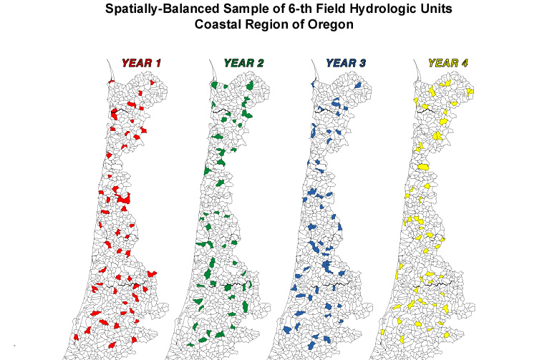

Slide 43
Temporal Design: Study-wide Monitoring When Multiple Years Required
Design
monitoring
program
Rotating regions
Each year monitor subset of study region using probability survey
Complete all subsets in 5-years
Study-wide
Each year monitor entire study region using 1/5 of sample size
Complete all sites to be sampled in 5-year
Strengths and Weaknesses
Rotating regions may have logistical advantages, produces regional results at end of year, and study-wide estimates at end of 5 years
Study-wide produces study-wide estimates each year and typically takes 5-years to produce regional estimates.

Slide 44
Response Design
Design
monitoring
program
What will be measured or collected in the field
How will it be measured or collected
Where the measurements be made within each of the spatial units comprising the sample (field plot design)
How sampling will be distributed within the temporal unit (e.g. year)
Laboratory methods
Analytical procedures to calculate the metric values for each spatial unit from the measurements

Slide 45
Response Design
Design
monitoring
program
Separate response design required for each metric
Each metric should be directly associated with a monitoring objective
Field operation requires integrating response designs for all metrics – especially field plots and temporal visit/revisit protocols.
Field operations manual
describe what and how attributes will be measured and recorded or samples will be collected, preserved and shipped
Laboratory operations manual
Information management manual
Analytic procedures for converting measurements or laboratory results into metric values (e.g., species richness metric, summary across multiple visits)

Slide 46
Response Design: Spatial & Temporal
Design
monitoring
program
Response design for a metric may require a spatial design (field plot) within the spatial unit unless the measurements can be taken at a point
Response design for a metric may require a temporal design within the temporal unit
Multiple visits within temporal unit (e.g., quarterly, monthly)
Index period (e.g., summer within a year)
It is as short as possible within field operational constraints
Variation in measurements is as small as possible within the window
It is ecologically based

Slide 47
The Response Design: Index Period
Time period within year selected for measurement (ecologically based)
Measurements may be taken more than once during index period with response design giving protocol for obtaining single value for indicator
Indicator variability within index period contributes to non-survey sampling error

Slide 48
Spatial-Temporal Design & Response Design
Design
monitoring
program
Spatial-temporal design is process of selecting spatial-temporal units at which a response (metric) will be determined
Which units (sites) will be visited (spatial design)
Which year units (sites) will be visited (temporal design)
Response design is process of obtaining a response (metric) on a spatial-temporal unit:
When unit (site) will be visited within a monitoring season
A single index period visit during a monitoring season
Multiple visits during monitoring season: e.g. monthly, quarterly
Field plot design
Process of going from basic field measurements to metrics
Notes:
Monitoring design can be thought of in terms of a survey design and a response design. The split is somewhat artificial but is useful in the design process.
Site can refer to (1) a specific location in an estuary, lake, wetland, or stream, or (2) to an entire lake, an entire stream segment, an entire wetland, an 8-digit hydrologic unit, or any other object such as a pixel from satellite imagery.
Field plot design may be a single location or may be multiple locations. Multiple location examples include transect centered at site, systematic sample of lake shoreline, or multiple habitat locations in lake to acquire fish community sample for a lake.
How the elements of the target population are defined for an aquatic resource is related to what is considered part of the survey design and what is part of the response design.

Slide 49
Inference Design for Indicators
Design
monitoring
program
Great point to evaluate whether the prior design pieces for monitoring program will meet your objectives
Indicators are associated with Reporting Domains which may require metric summaries across spatial units and temporal units
Organized around three types of indicators (or objectives)
Status
Temporal pattern (change, trend)
Spatial pattern (map)

Slide 50
Inference Design: Sample Size
Design
monitoring
program
Statistical quality requirements must be translated into sample size requirements
Margin of error used to determine sample size
For each indicator and reporting domain
Based on spatial survey design
Requires prior information on variance for each metric
Change and trend power requirements
Impact sample size
Selection of spatial-temporal design (i.e., panel structure, survey over time)

Slide 51
Inference Design: Status
Design
monitoring
program
Each spatial survey design is linked with a design-based statistical analysis appropriate for that design
Stratified design uses a stratified statistical analysis
Unequal probability design uses an unequal probability statistical analysis
Design-based analyses are based on the Horwitz-Thompson theorem for probability survey designs
Statistical sampling books provide required information

Slide 52
Inference Design: Change
Design
monitoring
program
Estimating change between two periods depends on the temporal design
Revisiting same spatial units in both temporal periods
Have paired data so procedures used to take advantage of pairing
Analysis may be based on differences for continuous data
Analysis may be based on two-way tables for categorical data
Can estimate gross change
No revisits of same spatial units in both temporal periods
Can only estimate net change
Analyses based on differences between indicator values for two periods.

Slide 53
Inference Design: Trend
Design
monitoring
program
Requires temporal design that covers multiple temporal units
Simple approach is trends in status estimated for each temporal unit
More complex analyses incorporate spatial-temporal design structure by using metric values on all spatial-temporal units sampled
Typically rely on statistical linear model analyses
Example: VanLeeuwen, D.M., L.W. Murray and N.S. Urquhart 1996. A mixed model with both fixed and random trend components across time. Journal of Agricultural, Biological and Environmental Statistics 1:435-453

Slide 54
Inference Design: Spatial Pattern
Design
monitoring
program
Model-based approaches are required
Geostatistics (Kriging) when resource is an area
Geostatistics when resource is a linear network (new methodology)
Spatial prediction models incorporating auxiliary information
Generalized linear models
CART: classification and regression trees
Random forests

Slide 55
Convey
Develop
Design
Results
and
monitoring
monitoring
objectives
program
findings
Monitoring Objectives specify: Spatial domains, Spatial units, Temporal domains, Temporal Units, Reporting domains, Indicators, Statistical Quality
STRIDe specifies based on monitoring objectives: Spatial design, Temporal design, Response design (including metrics and measurements), and Inference Design (including sample size)

